Slide 1


PlanetScope Data
GEOG 823
Mohammed

Slide 2
PlanetScope Data
Spatial resolution of 3 meter
3 types of Satellites
PS2 Dove-C
2017 - 2023
3 Bands ()
Red, Green and Blue
PS2.SD Dove-R
2019 - 2022
4 Bands (R,G,B and NIR)
PSB.SD SuperDove
2020 - Ongoing
8 Bands (R,G, G1, B, NIR, Y, R, RE and CB)
7m

Slide 3
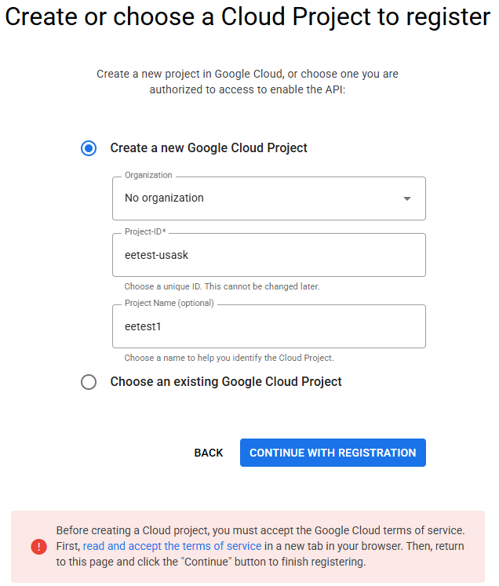
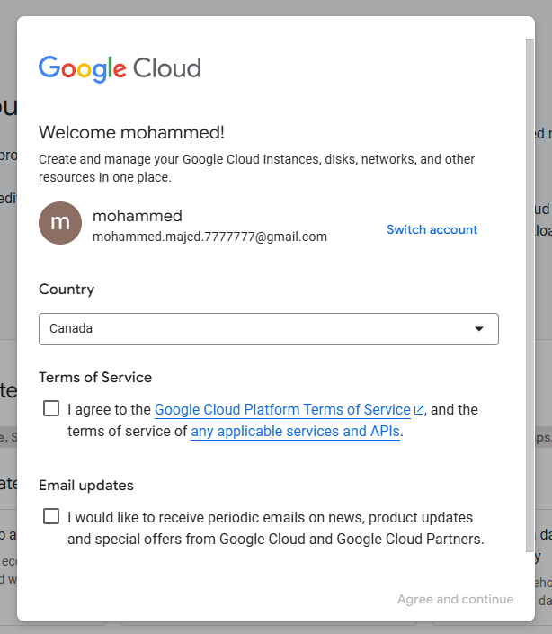
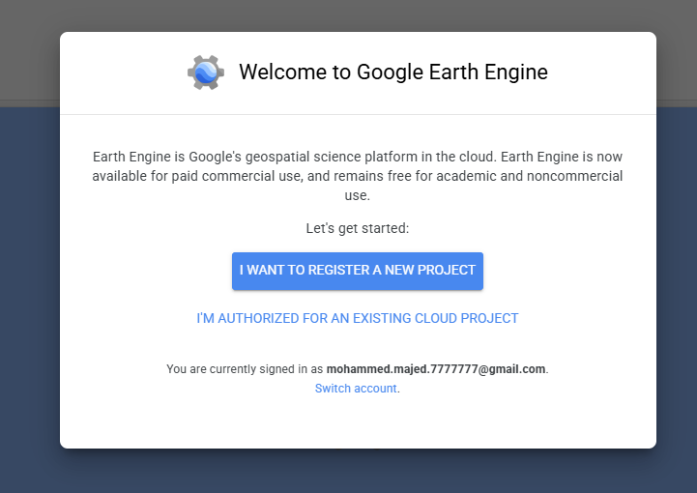
How to connect with Google Earth Engine?
Have an Earth Engine account
Integrate your GEE account with google cloud platform (console.cloud.google.com)
Register a Google Cloud Project (GCP) project
3
1
7m
2

Slide 4
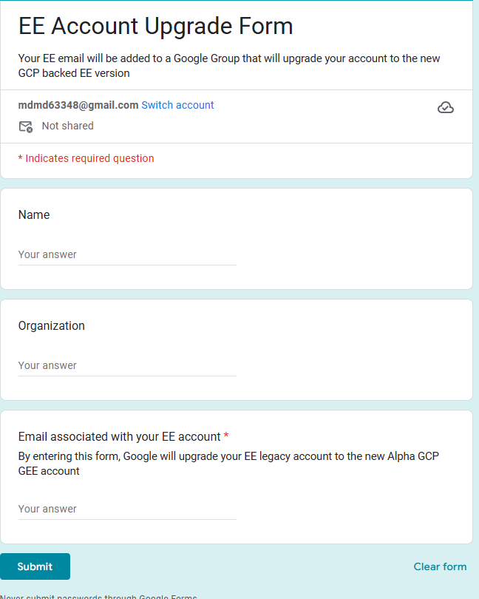
How to connect with Google Earth Engine?
Have an Earth Engine account
Update your EE account using the form
7m
https://docs.google.com/forms/d/e/1FAIpQLSdUR5j6lfcsTh3k5H1RJYKQKLRgSheAzKLkYfDdnx9YQ6wUtw/viewform

Slide 5
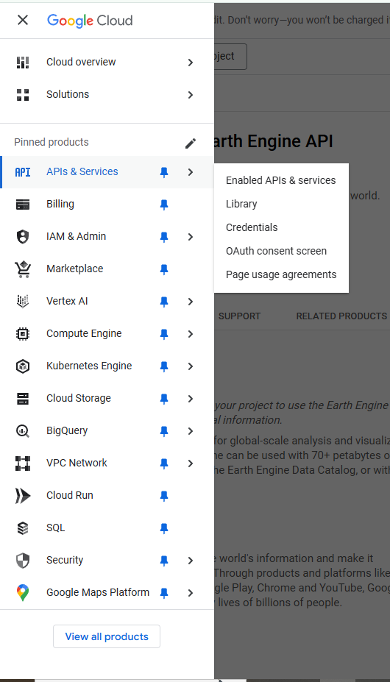
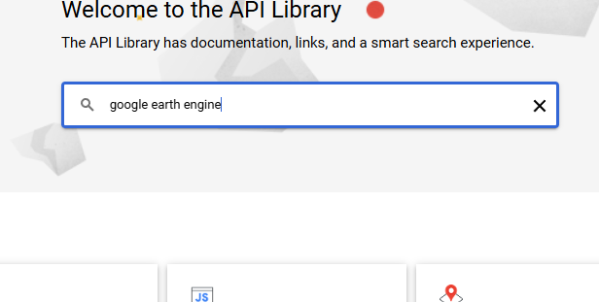
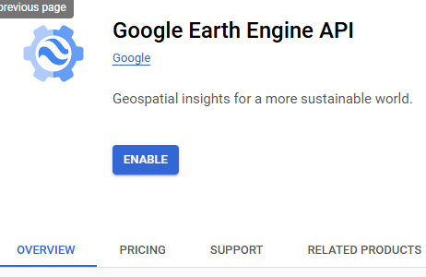
How to connect with Google Earth Engine?
Have an Earth Engine account
Enable the EE API for the project
Goto console.cloud.google.com
From the navigation panel, go to API library
Search “Google Earth Engine API”
Then, enable the API
1
2
7m
3

Slide 6
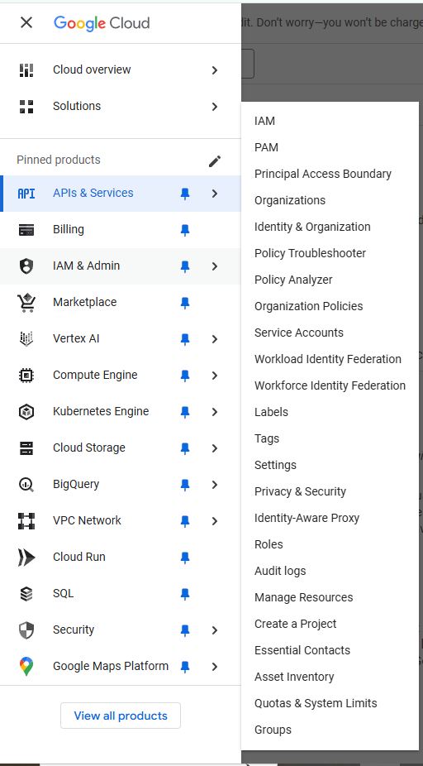
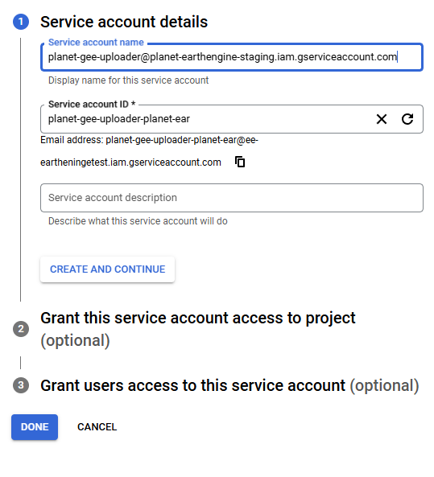
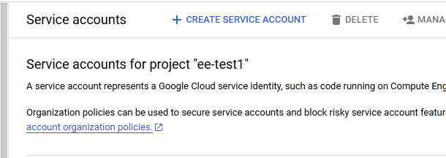
How to connect with Google Earth Engine?
Have an Earth Engine account
Grant Planet access to GEE
Goto “Service Account”
Select Create Service Account
NAME: planet-gee-uploader@planet-earthengine-staging.iam.gserviceaccount.com
ROLE: Earth Engine Resource Writer
7m

Slide 7
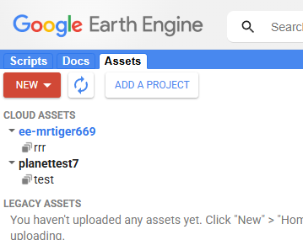
How to connect with Google Earth Engine?
Have an Earth Engine account
Grant Planet access to GEE
Goto “Service Account”
Select Create Service Account
Registered project
Image Collection
7m

Slide 8
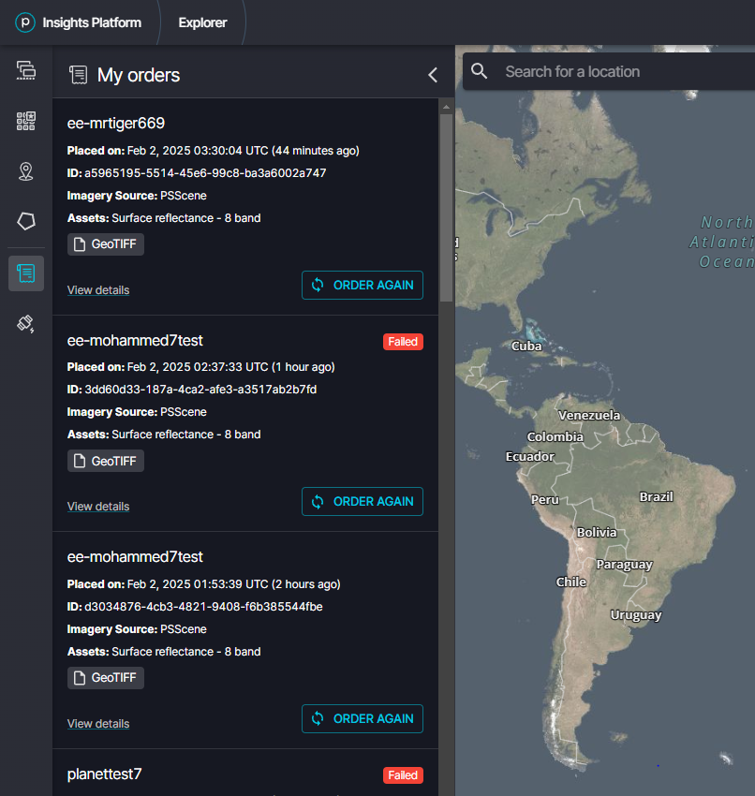
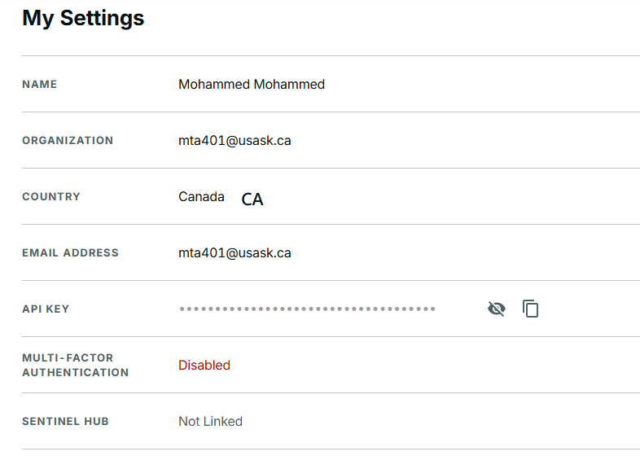
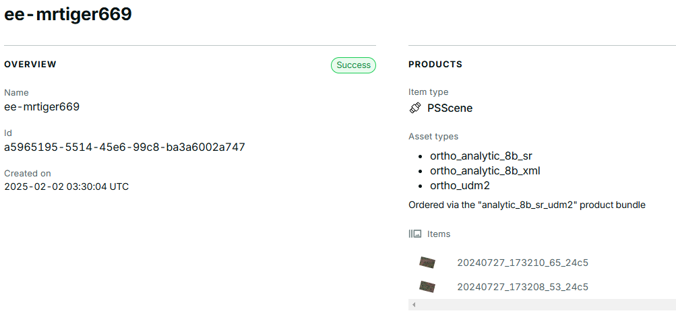
How to connect with Google Earth Engine?
7
PlanetScope to GEE delivery
After selecting and placing order in the Explorer go to My account
My order: Image ID
My account: API KEY
Go to postman.com
PS Explorer
Order ID
PS Account
API KEY
7m
Image ID

Slide 9
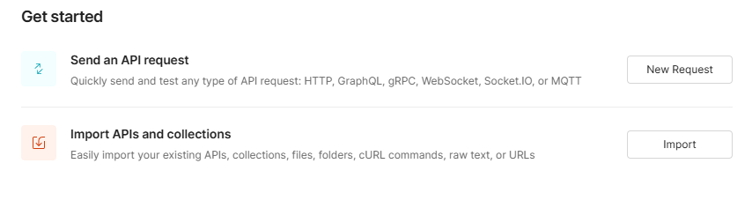
How to connect with Google Earth Engine?
PlanetScope to GEE delivery
In postman.com
7
Order ID
PS Account
API KEY
7m

Slide 10
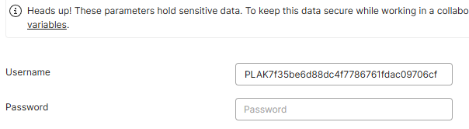
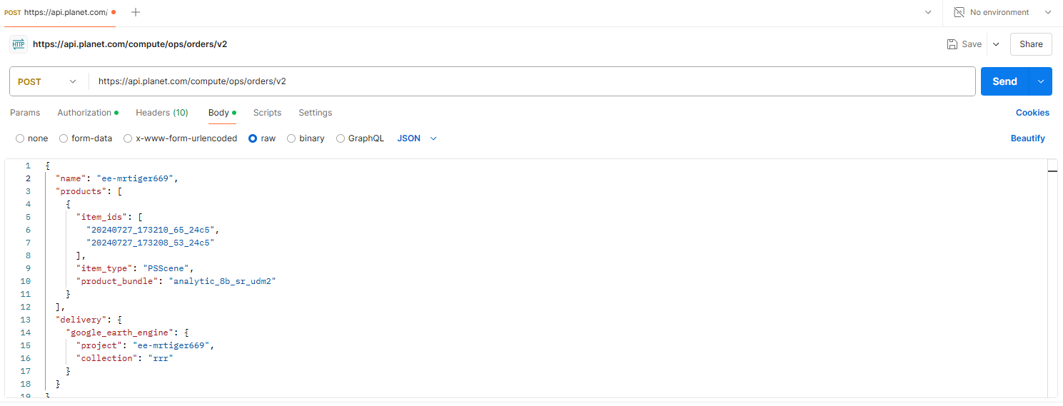
7
Select ‘POST’
PS URL
Image ID
Earth Engine project name from GEE
Image collection name from GEE

Slide 11
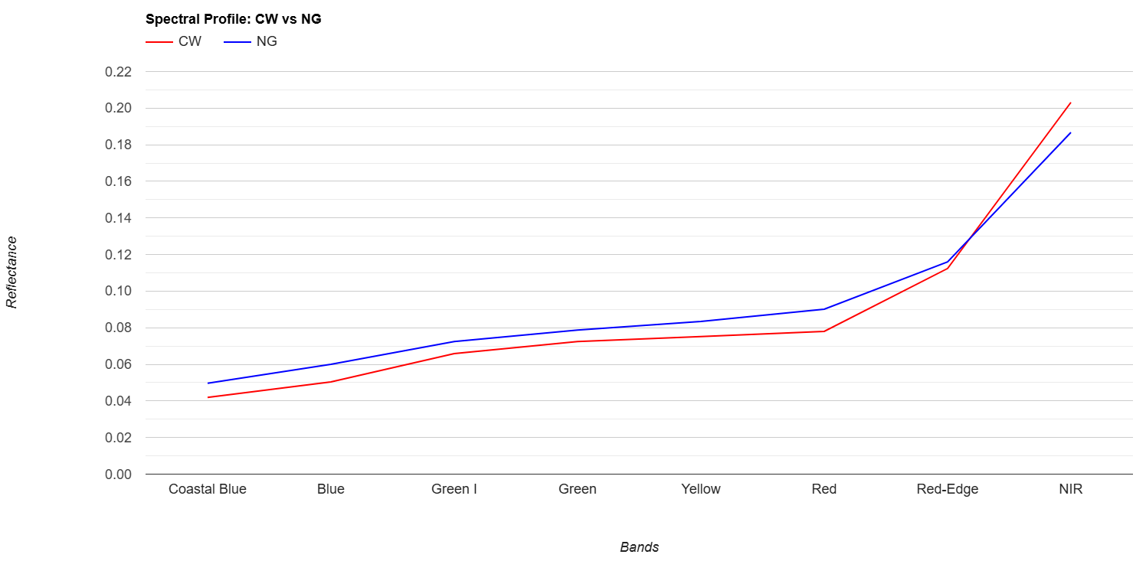
7

Slide 12
7
My Script
https://code.earthengine.google.com/9c0ce46fd3f1d028782d4c851a222502
My PlanetScope Image assest in GEE
https://code.earthengine.google.com/?asset=projects/mohammedusask/assets/test

Slide 13
7
https://developers.planet.com/blog/2023/Feb/23/gee-integration-a-planet-developers-deep-dive/
https://support.planet.com/hc/en-us/articles/115013886368-How-is-the-Surface-Reflectance-Product-Provided
https://support.planet.com/hc/en-us/articles/4404581999761-How-to-Place-a-Basic-Imagery-Order-Using-Postman
https://developers.planet.com/apis/orders/scenes/
https://gis.stackexchange.com/questions/389381/planetscope-image-delivery-to-google-earth-engine
https://www.youtube.com/watch?v=Z7FVA8OVj64
https://gis.stackexchange.com/questions/389381/planetscope-image-delivery-to-google-earth-engine
https://gis.stackexchange.com/questions/tagged/planet
https://gis.stackexchange.com/questions/480076/connecting-planet-imagery-orders-to-google-earth-engine
https://gis.stackexchange.com/questions/480076/connecting-planet-imagery-orders-to-google-earth-engine
https://gis.stackexchange.com/questions/316089/convert-planet-imagery-surface-reflectance-product-dn-to-surface-reflectance-val

